Slide 1
Academic Meeting FOR DMS Current 6th Graders 2021 - 2022 Course/Subject Request AS 7th Graders IN 2022-2023

Slide 2
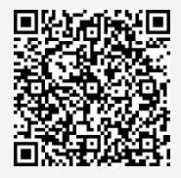
Academic Meeting FOR DMS Current 6th Graders
Agenda
Explanation of Required classes
Physical Education
Band
Explanation of Electives for incoming 7th Graders in 2022
Cyber Foundations I
Visual Arts
Explanation of sections on form
Questions, Comments, Concerns, Suggestions
QR Code Please
scan with camera phone to
sign in

Slide 3
Please select ONE of the following electives:
____________ Band: Instrument Played __________________
____________ Physical Education (PE)
Students are to select either Band or PE for 7th grade.
1. Student are NOT allowed to take both
2. When selecting Band, student must include the instrument played
a. Band classes are divided into specific areas: Woods, Winds, and Brass
B. If you are a beginner, please write that as well

Slide 4
Please select ONE of the following electives:
____________Cyber Foundations 1 (1 High School Credit)
or
______________ Visual Arts (1 High School Credit)
Information:
Both classes will earn student 1 credit towards High School Graduation upon completion and passing class.
Students will be offered both classes as an 8th Grader
Visual Arts is offered in high school as well

Slide 5
Please select ONE of the following electives:
ONLY Gifted/Journey Students are to complete this section:
______________7th Grade Journey
(must have been enrolled in Journey as a 6th grader)
OR
______________ US History

Slide 6
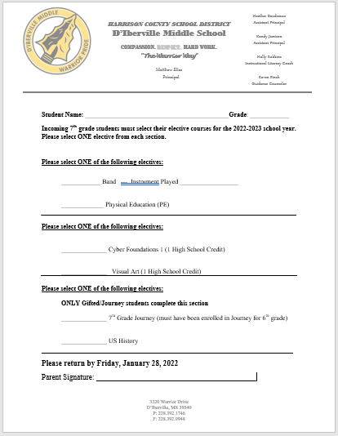
ALL 6th Graders came home
with this form.
Please fill out and return
to your child’s teacher.
Thank you,
DMS

